Slide 2
IEEE EMC GERMAN CHAPTER
Christian Schuster (Chair)
Matthias Tröscher (Vice Chair)

Slide 3
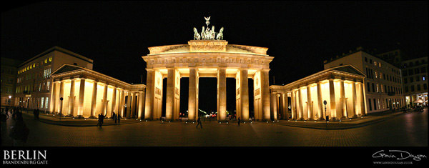
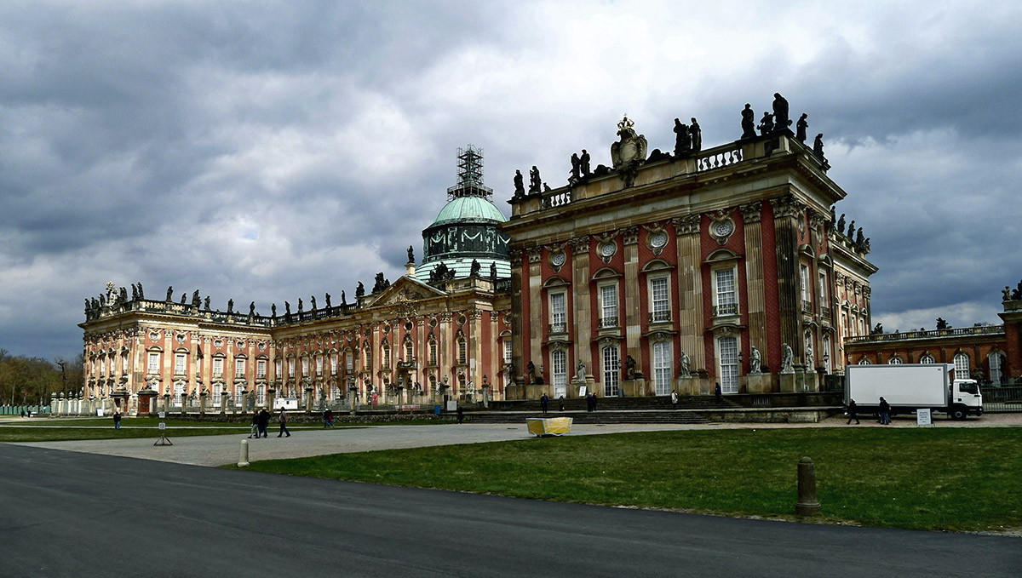
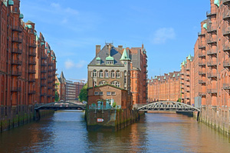
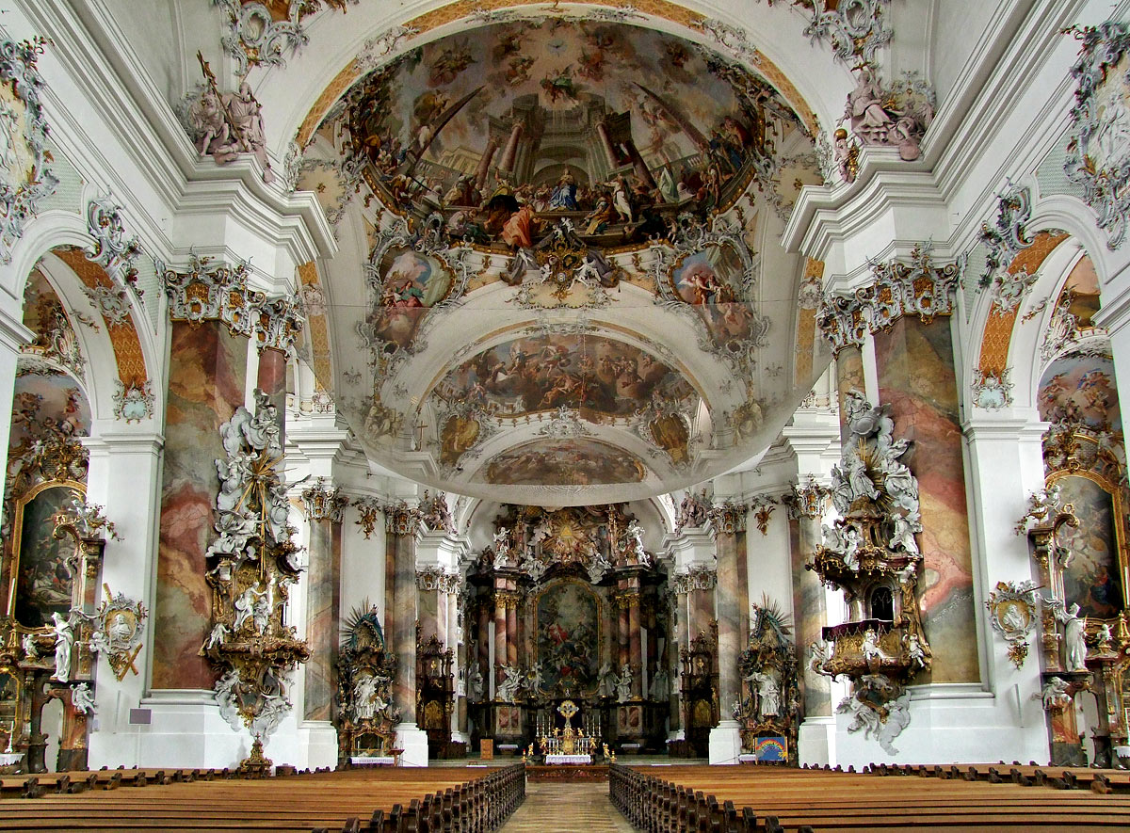
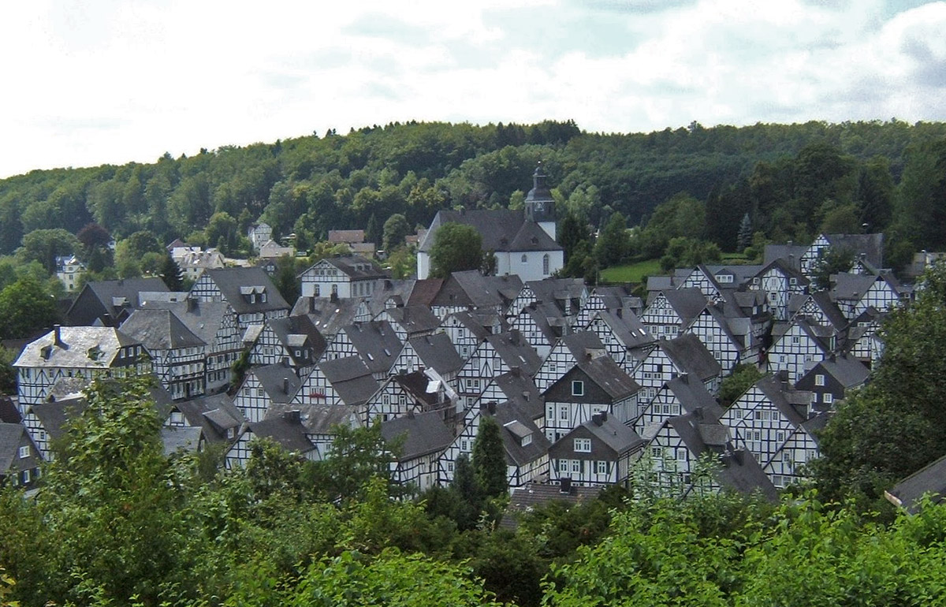
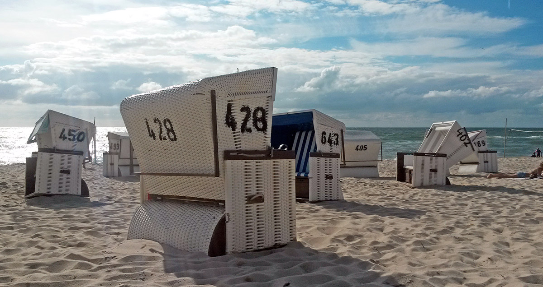
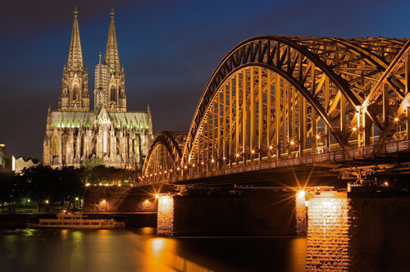
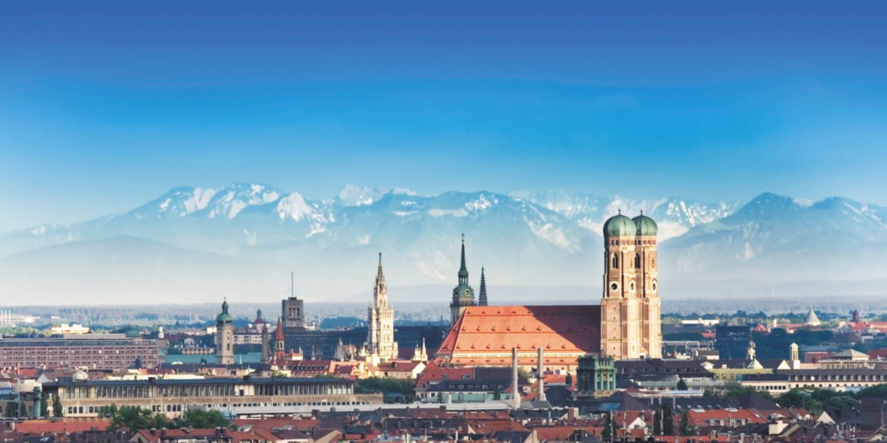
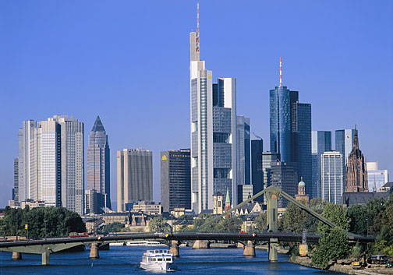
Germany in Pictures

Slide 4
Executive Committee
Election to Executive Committee in Q1/2016
Novelty in Germany: members from both academia and industry
All committee members with industrial background
Well balanced between software and hardware EMC experts

Slide 5
New Homepage

Slide 6
Recent Activities
Annual Member Meeting in Nov 2015 at Technical University Wuppertal
Distinguished Lectures in April 2016
“What I Wish I Knew about EMC Simulation when I First Started” by Scott Piper
“EMC Issues of Tomorrow’s New Automotive Technologies – Impacts on Specifications, Design and Validations” by Marco Klingler
EMC Chapter Meeting at EMV 2016 Düsseldorf in February 2016
Task Force lead by Prof. Dickmann from HSU Hamburg established recommendations for an EMC Core Curriculum with experts from academia and industry in the years 2011-2014. The recommendations give a selection of topics for curriculum content for a Broad Education in the field of electromagnetic compatibility and are constantly being updated.

Slide 7
Future Activities
EMC Workshop at ICCE 2016 in Berlin on September 6, 2016
EMC Boot Camp at Helmut-Schmidt-Universität / Universität der Bundeswehr on October 12-13, 2016
Magdeburger EMV Industrieseminar on October 25, 2016
23rd Annual Member Meeting in Nov 2016 at Technische Universität Dortmund

Slide 8
EMC Boot Camp Flyer

